Slide 1
Are Yelp’s First Reviewers’ Biased?
Notes:
Sravanthi

Slide 2


Sravanthi Prattipati
Ajinkya Bhavik
Meet the Team
Notes:
Sravanthi

Slide 3
Question
1
Notes:
Sravanthi

Slide 4
How does Yelp’s first reviews compare to the average reviews of the business?
Notes:
Sravanthi

Slide 5
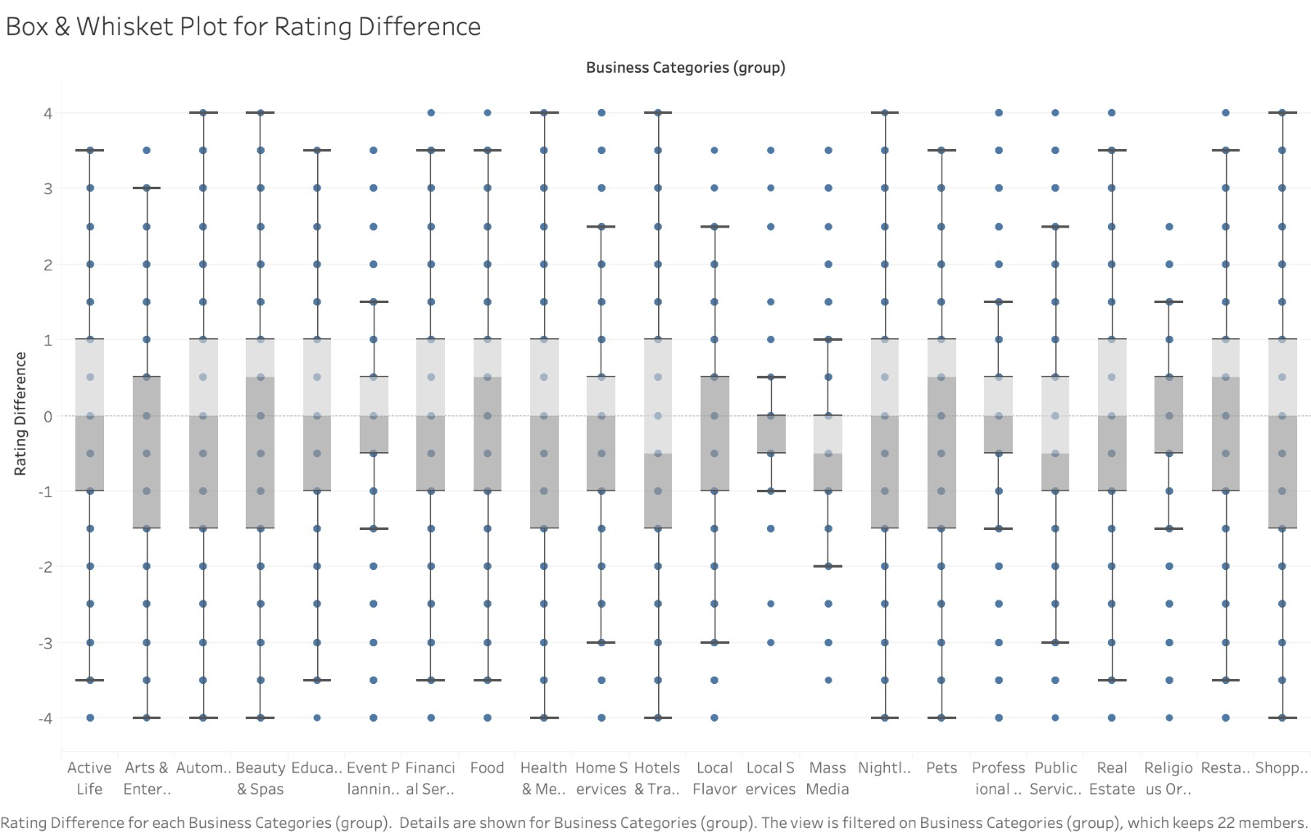
Rating Difference: First Review - Average Business Rating
First Review Rating Difference over Different Categories
Notes:
Sravanthi

Slide 6
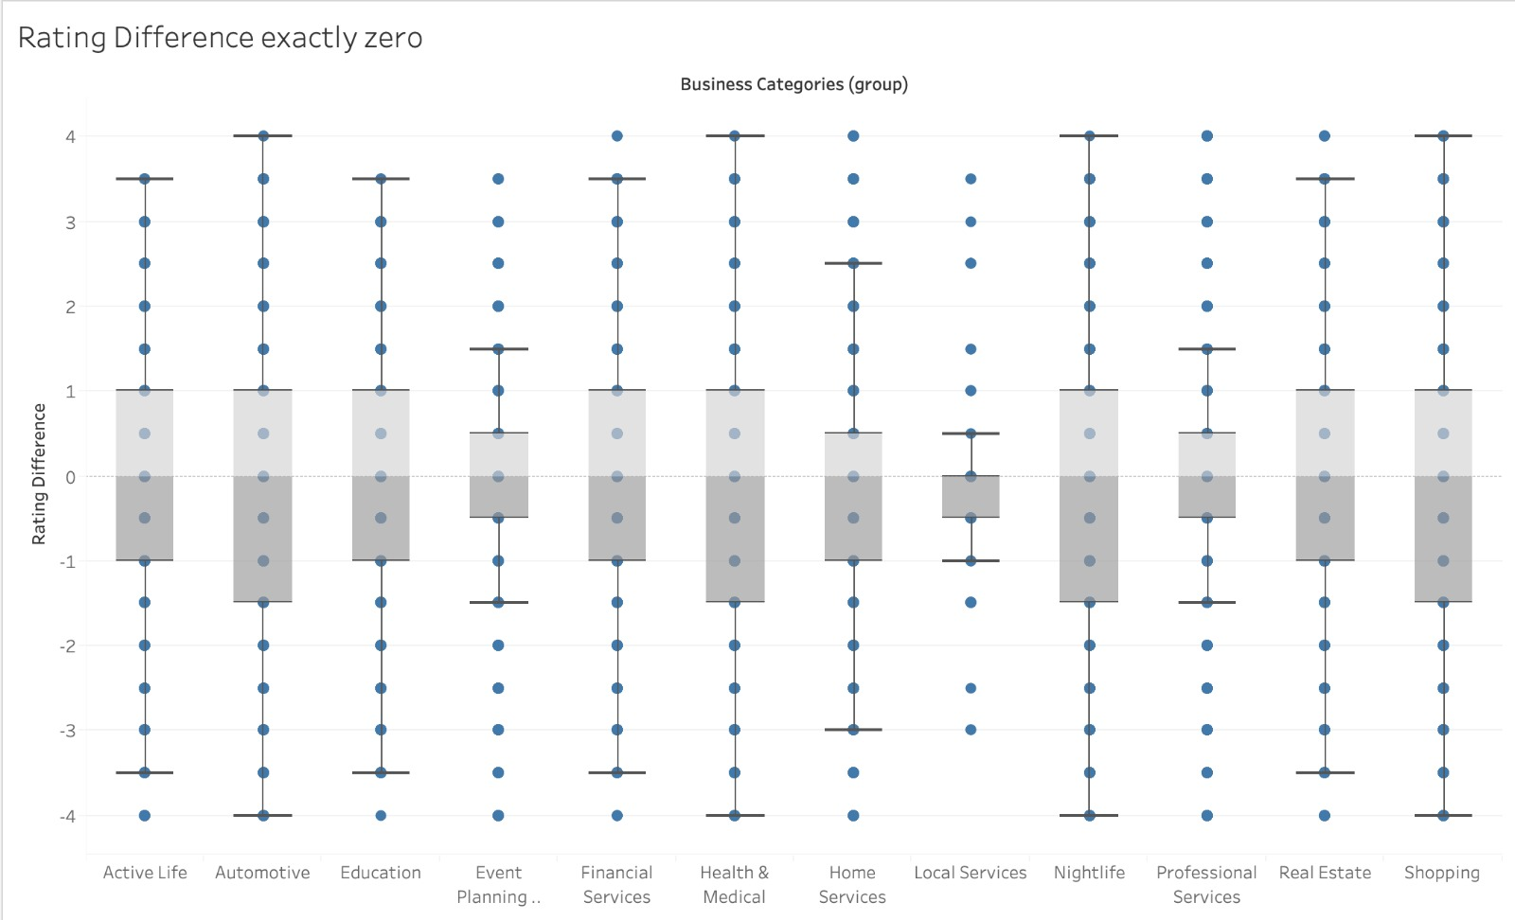
Median = 0; (First Review = Average Review for the Business)
Notes:
Sravanthi

Slide 7
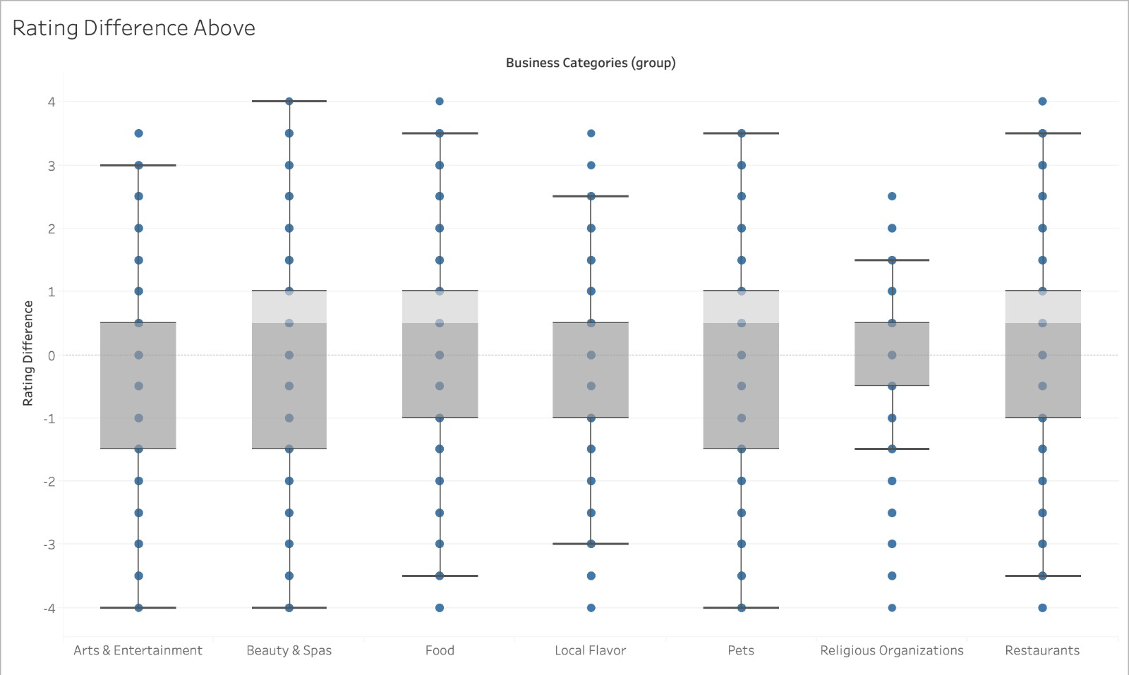
Median > 0; (First Review > Average Review for the Business)
Notes:
Sravanthi

Slide 8
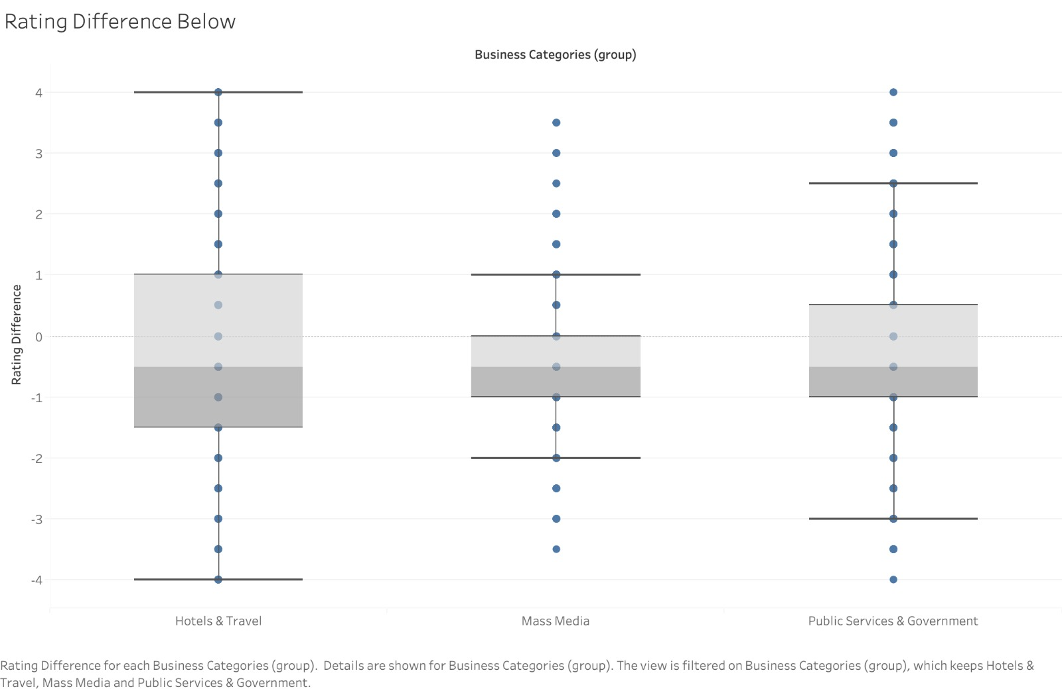
Median < 0; (First Review < Average Review for the Business)
Notes:
Sravanthi

Slide 9
What categories do people review for their first review?
Notes:
Ajinkya
Okayy Thankyou Sravanthi Now let's look at exactly which categories do people review in their first reviews and what is the percentage spread of the ratings within these first reviews. This is essential to know which business prompts a user to join yelp for the first time and the categories that they belong to.

Slide 10
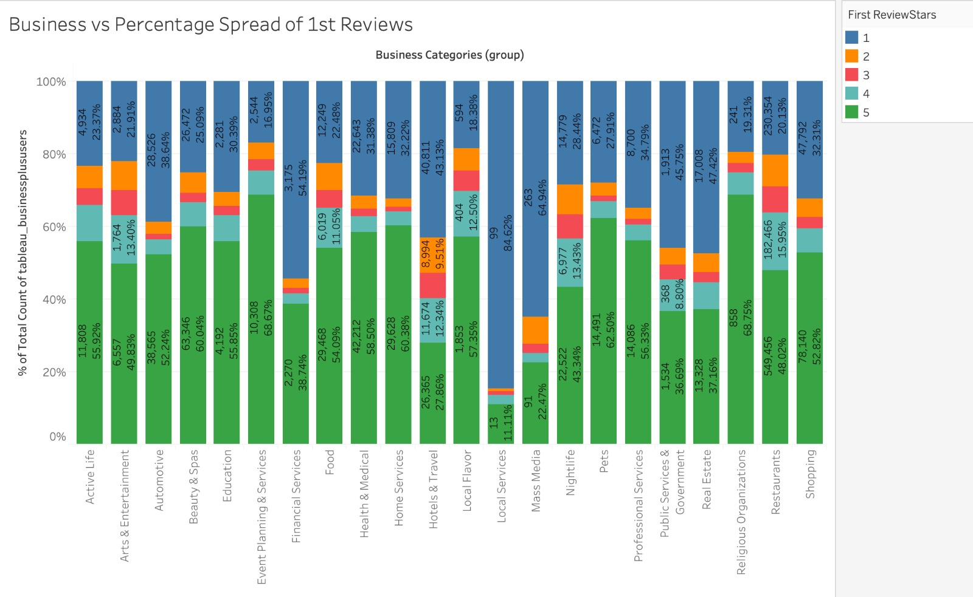
% of users with first review within different categories
First Review Rating Spread Across Different Business Categories
Notes:
Ajinkya
Here we see in this visualization, the first review stars from a scale of 1 to 5 are spread in a particular category showing varying percentage concentrations. We notice certain categories having the high concentration of rating 1 like Financial Services, Local Services, Governmental Services. This maybe due to people receiving low quality services thus being disappointed and in turn giving low rating. Like for instance if a customer has to wait for a really long time to avail a government service as his time gets wasted, he may tend to give a lower rating to that service. On the other hand we also notice certain categories having higher concentrations toward a higher rating of 4 or 5 like restaurant or active life. This is usually the case since a customer usually being hungry tends to like the food he receives in front of him may end up giving a higher rating just like someone doing adventure sports in active life may almost always gave a higher rating for enjoying and surviving such a near death experience. Some categories also showed a neutral spread within all ratings like Hotels and Travel and Nightlife. These could be because both belong to a similar domain wherein reviews depend on a particular individual’s experience of the night or the event. Now lets take a lot at top 3 lowest and highest rating categories.

Slide 11
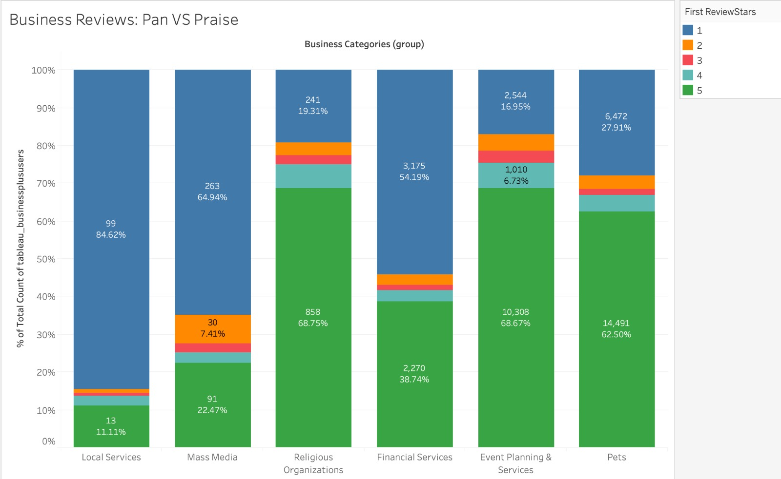
Top 3 Categories where users join to pan/praise a business
Notes:
Ajinkya
Looking at the top 3 categories with the lowest and highest ratings we get an idea of userr from which categories join yelp to pan a business and which users join to praise a user. Look at the stacked bar chart above we get that users from local services, mass media and financial services join yelp to pan the business as we can see that those have the highest concentration of first reviews with 1 rating. Mass media and local services are some categories where in a customer is not satisfied in the first output he gets or is made to wait for a long time for his output. Due to which a user may end up joining yelp to pan a business in frustration. We also notice from the stacked bar chart that Religius Organizations, Event Planning and Pets are categories which have recieved the highest 5 star rating. Since pets are usually assocviated with positive emotions, it is viable and it makes sense that a user may go online and be happy to give in a review for the servicec provided and the puppy or any pet that they have adopted. Religiois organizations also are institiutions of faith so their customer service tends to be in line with the customers demand which are few and hence tends to be praised in first reviews often.

Slide 12
Limitations
2
Notes:
Ajinkya
There are a few limitations that we too faced during out project work and while vizualising these results. Hence we will look at them in the next few slides.

Slide 13

Databricks Limitations
Since yelp data is spread out around different countries we were only able to take the metro areas.
Maintaining multiple tables while switching between pyspark and spark sql was a little time consuming.
Data Integrity was a bit difficult since the data sizes for different categories were varying but we solved these issues in Tableau
While attaching the tableau link, databricks didn’t allow to show all sheets as an image, but only showed the one which is put a header images in the tableau desktop.
Notes:
Ajinkya
Since yelp data is spread out around different countries we were only able to take the metro areas. This turned out to be more feasible and suitable for our analysis purposes as the spread of data was more in the data areas. But being able to take more data from different cities and areas except would have definitely been helpful.

Slide 14
Tableau Limitations
Tableau took forever to run because of low processing power and higher amounts of data
Each business is tagged with multiple categories. When we grouped data one business had to go under only one category even if it originally could coexist under several categories. We decided to group them on tableau instead of databricks
Spinning up and maintaining of clusters esp if connected with tableau since databricks still considered the cluster to be idle. Thus terminating while viz is in process in tableau.
Notes:
Ajinkya

Slide 15
Why should Yelp care?
3
Notes:
Sravanthi

Slide 16
Are first reviews accurate representation of how the business is doing?
Notes:
Sravanthi

Slide 17
Analysis
Overall, it is accurate for:
Active life;
Automation;
Education;
Event planning;
Financial services;
Health and Medical;
Home services;
Local services
Nightlife;
Professional Services;
Realestate;
Shopping
Notes:
Sravanthi

Slide 18
Analysis
Overall, it is overrated for:
Arts and Entertainment;
Beauty and Spas;
Food;
Local flavor;
Pets;
Religious organization;
Restaurant;
Notes:
Sravanthi

Slide 19
Analysis
Overall, it is underrated for:
Hotels and Transportation
Mass media
Public service
Notes:
Sravanthi

Slide 20
What should Yelp do?
4
Notes:
Sravanthi

Slide 21

Recommendations
Notes:
Sravanthi

Slide 22
What should Yelp focus on?
Weightage
Focus
Market
Yelp should consider to place a lower weight on the first reviews for the categories where the first revieviwers tend to overrate or underrate to balance out the bias.
Yelp can focus on auditing/paying close attention to the businesses who are getting first review ratings that vary highly from their average to ensure that no incentives are being provided by the business for the users to rate the business in a certain way.
Yelp could focus on adding more businesses to the categories that has least # of first reviews to expand into those markets.
Notes:
Sravanthi

Slide 23
Moving Forward
Steps for future work:
Compare user’s first review and business average reviews while adding elite users as a filter.
Praising and panning ratio in first reviews different for elite users?
Work hours timings or locations which affect the rating range of reviews from 1 to 5?
Notes:
Ajinkya
Compare user’s first review and business average reviews while adding elite users as a filter. This will help in realizing if the rating difference changes for elite and not elite users.
Work hours timings or locations which affect the rating range of reviews from 1 to 5?. For example coast areas having higher rating due to most popular categories are rated highly here like nightlife or active life as compared to central areas. So does location pay a central role is something we can dfinitely consider.

Slide 24

Thanks!
Notes:
Ajinkya
Well now we are at the end of our presentation. We thankyou professor for giving us the opportunity to work on such an intersting topic and for everyone for being such a ptient audience. Wish you all a great day ahead. tHANKYOU.

